Slide 1

kubernetes cybersecurity defense system

Slide 2
About us
Ziad Mahmoud Ali
Mohaned Mahmoud Sabry
Mohamed Hassan Mohamed
Loai Ahmed Mostafa
Seif Yasser Abd-El Razik
Shimaa Rabia Ewass
2

Slide 3
Supervisors
Dr. Mervat Al Qutt
T.A. Abdelrahman Ali
3

Slide 4
Agenda
Problem Definition
System Analysis & Design
Techniques & Algorithms
Experiment Setup
Practical Work & Implementation
Problems Faced
Project Roadmap
4

Slide 5
1. Problem definition
Modern Kubernetes environments are highly dynamic and exposed to threats like SSRF and network scanning attacks. Traditional solutions are reactive, manual, and too slow to respond.

Slide 6
1. Problem definition cont.
No Real-Time Detection
THE SECURITY GAP
Manual Failure: Reactive solutions fail to keep pace with automated exploits.
Lack of Real-time: Significant delay between detection and isolation.
Visibility: Raw traffic often remains unanalyzed for malicious patterns.
Malicious network behavior goes undetected until significant damage is done.
No Intelligent Analysis
Traffic is not analyzed with AI, missing complex attack patterns.
No Automated Response
Manual intervention leaves a critical window for attackers to exploit services.
6

Slide 7
2. System Analysis & Design
System Requirements
Capture real-time network traffic using a sniffer
Convert raw traffic into structured data (CSV features)
Analyze traffic using an AI model
Detect malicious activities such as SSRF and scanning attacks
Automatically respond by redirecting traffic to a honeypot
Real-time performance (low latency detection)
High reliability and availability
Scalability to handle increasing traffic
Security and isolation between components
Efficient data sharing between pods
Strict security boundaries between all pod components
Functional
Non-Functional

Slide 8
2. System Analysis & Design cont.
AI Detection
Feature Extraction
Packet Capture

Slide 9
2. System Analysis & Design cont.
The System Architecture has multiple components:
Sniffer Module:
Captures live network packets and stores them as PCAP files
This design ensures automation, scalability, and fast response to threats.
Flow Processing Module (CICFlowMeter):
Converts PCAP files into CSV format with extracted features
AI Detection Module:
Uses a trained ML model to classify traffic as normal or attack
Security Controller:
Monitors outputs and triggers automated response actions
Honeypot System:
A decoy environment to trap and analyze attackers
Real-time Storage:
Using a script in powershell called kubectl-cp that makes a powershell sync.
Decrease latency from 30 seconds to 2 seconds.
Shared Storage (PVC):
Ensures all components access the same data

Slide 10
3. Techniques & Algorithms
NB
Decision & Logic
Uses a Naive Bayes classification model
Preprocessing includes scaling and feature alignment
Classifies traffic into Normal or Attack (SSRF / scanning)
The system monitors the output of the AI Detection Module. If malicious behavior is classified:
Naive Bayes Algorithm

Slide 11
4. Experiment Setup
The experiment was conducted in a controlled Kubernetes environment using a multi-node cluster.
Setup Details:
A Kubernetes cluster was created with one control plane and multiple worker nodes
A Persistent Volume (PV) and Persistent Volume Claim (PVC) were configured for shared storage
Multiple namespaces were used to isolate components (e.g., security, production, attacker)
An attacker pod was deployed to simulate malicious traffic (e.g., scanning attacks)
Core components deployed include:
Sniffer for capturing traffic
CICFlowMeter for feature extraction
AI detection service
Security controller
Honeypot and real application
This setup ensures a realistic environment for testing real-time detection and response mechanisms.

Slide 12
5. Practical Work and Implementation
Implementation Steps:
Captured live traffic using tcpdump inside a Kubernetes pod
Processed captured data using CICFlowMeter to generate CSV files
Developed a Flask-based API to host the trained machine learning model
Implemented a Python-based security controller to monitor outputs and send requests to the AI service
Integrated Kubernetes API to dynamically patch services based on detection results
Deployed a honeypot environment to redirect and trap malicious traffic
Built a real-time monitoring dashboard to visualize system status
The system was implemented as an integrated pipeline combining networking, AI, and Kubernetes automation.
Execution Flow:
Traffic is captured and stored
Data is converted into features
AI analyzes the data
Controller detects attack
Service is patched
Traffic is redirected to honeypot
This implementation demonstrates a fully automated, real-time cybersecurity defense system.

Slide 13
5. Practical Work and Implementation Cont.
1. Module Objective Discovery active, intelligent threat detection against SSRF in K8s
2. Core Methodology Targeted Task: Binary classification (Benign vs. SSRF)
Algorithm: Gaussian Naive Bayes for O(n) efficiency and low latency Data Optimization: Strict class balancing and Standard Scaler application

Slide 14
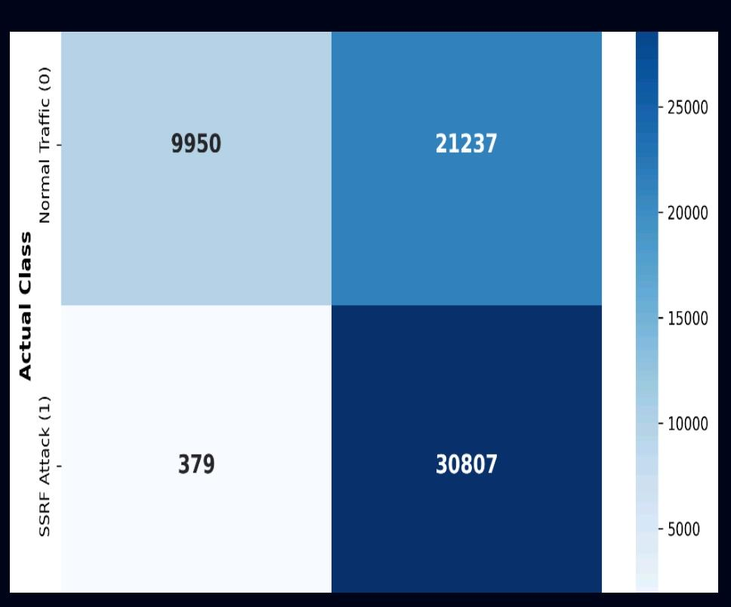
5. Practical Work and Implementation Cont.
3. Results & Confusion Matrix Analysis Performance: 99% SSRF Recall Rate | 65.3% Overall Accuracy.
Architectural Trade-off: Suspicious traffic (False Positives: 21,237) is safely redirected to the Decoy, NOT blocked. Threat Mitigation: Successfully captured 30,807 attacks with minimal False Negatives (379).

Slide 15
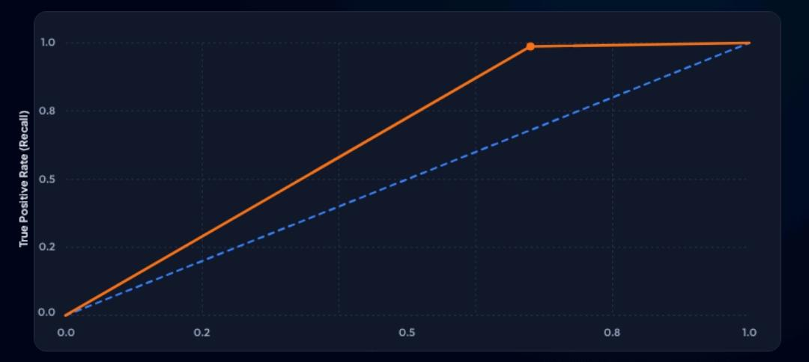
5. Practical Work and Implementation Cont.
5. Receiver Operating Characteristic (ROC)Statistical Capability: The ROC Curve validates the separation capability of the Naive Bayes classifier between benign and malicious flows.
Despite the high False Positive rate, the AUC of 65.53% confirms the model retains statistical power. The curve stays clearly above the baseline, indicating successful pattern differentiation.

Slide 16
6. Problems Faced
Challenge
Automated Mitigation & RBAC The Problem:
Permission Denied (403 Forbidden) Issue: By default, Kubernetes Pods are isolated and cannot modify cluster networking. Obstacle: Our Security Controller was blocked by the Kubernetes API when trying to redirect traffic, as it lacked the authority to "Patch" services.
Solution
Implementing RBAC (Role-Based Access Control) We granted the Controller "Write" access safely using three components:
Service Account: Created a unique "Identity" for the Controller.
Role: Defined a strict set of permissions (Only patch and update for Services).
Role Binding: Linked the Identity to the Permissions.

Slide 17
6. Problems Faced Cont.
Challenge
Real-Time Data Sync & Latency The Problem:
30-Second Sync Gap Isolation: Data generated by the Sniffer is "trapped" inside the Pod's isolated file system. Latency: Standard shared storage (PVC) updates too slowly (10–30 second delay). Critical Risk: In cybersecurity, 30 seconds is an eternity; the attacker could finish their exploit before the AI even sees the data
Solution
High-Speed Sync
Bypass We bypassed the file-system lag by building a Direct Extraction Layer:
Continuous Loop: A PowerShell background script monitoring the cluster 24/7.
Forceful Extraction: Using kubectl cp to "grab" fresh CSV data every 2 seconds, ignoring the slow PVC sync.
Instant Injection: Direct delivery to the AI Controller and Live Dashboard.

Slide 18
7. Project Roadmap (Stages)
Phase 1:
Environment & Traffic Pipeline (Completed)
Infrastructure: Multi-node cluster with Namespaced Isolation and Shared Storage (PVC) for real-time data exchange.
Pipeline: Automated Sniffer Pod and Feature Extractor (CICFlowMeter) that converts raw packets into 80+ security features every 5 seconds.

Slide 19
7. Project Roadmap (Stages) Cont.
Phase 2:
AI Intelligence & Automated Defense (Completed)
Detection: Naive Bayes AI Model deployed as a live Kubernetes Service (ai-service) for instant threat classification.
Mitigation: Developed a Python Security Controller with RBAC permissions to automatically "Patch" services and redirect attackers.

Slide 20
7. Project Roadmap (Stages) Cont.
Phase 3:
Deception & Monitoring (Completed)
Honeypot: Deployed a Decoy environment to isolate and study attackers.
Dashboard: Real-time Streamlit interface for live threat alerts and system status.

Slide 21
7. Project Roadmap (Stages) Cont.
Final Phase:
Optimization (Ongoing)
Goal: Stress-testing the system with SSRF and Scanning attacks to maximize detection accuracy and reduce latency to under 1 second.

Slide 22
Thank you

